Slide 1
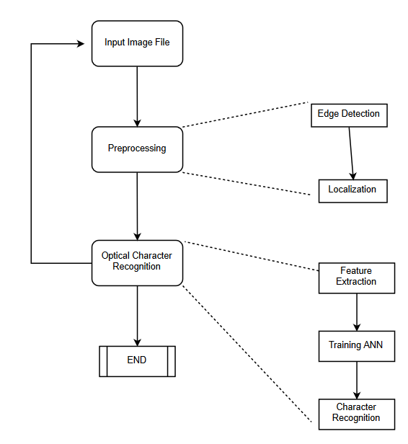
Automatic Number Plate Recognition
Department of Computer Science
Abhash Jain, Abhishek Srivastava, Ajay V, Darshan Bhandari, Deepak Gupta, Kamal Sharma
North Carolina State University
1. Introduction
3. <Technical section>
5. Parameter choices
Automatic Number Plate Recognition using Image Processing and OCR.
ANN was used and exploration of CNNs.
CNNs make the assumption that inputs are images.
K-L divergence is a measure of distance between distributions.
<Diagram for best performing model>
Input image -> Gaussian mixture model -> kNN to GMM templates using K-L divergence.
Batch size = 32,
Learning rate = 0.01,
Network architecture = 2 Hidden layers (400, 300) nodes
Activation function = Sigmoid/ Relu/ Tanh
Optimization algorithm: Adam/ Gradient Descent
These choices were used as they have proved to be successful in all neural network implementations.
2. Data description
4. Results
6. Conclusions
The dataset consists of images of individual alphanumeric characters.
The test images consist of images of cars, with the number plate clearly visible and has minimum reflection.
<diagrams showing the results of your method>
(For example,
For CNNs for classification, true positive, one false positive, one false negative. Learning curves for loss vs. number of iterations, training and testing accuracies vs. number of iterations.
For GMMs, a portion of the image (original and classified) that the method found hard to discriminate.
Table with performance of different methods under some accuracy measure.
Performance (qualitative or quantitative) of your methods under different parameter settings.)
Neural Networks perform better for image classifications compared to other classification algorithms.
Adam optimization converges faster than gradient descent.
7. References
Improved OCR based Automatic Vehicle Number Plate Recognition using features trained Neural Network.
https://ayearofai.com/rohan-lenny-1-neural-networks-the-backpropagation-algorithm-explained-abf4609d4f9d

